Slide 1
Standard User – Execute a Contract
February, 2013

Slide 2

Learning Objectives
Upon completion of this course you will be able to:
Add Internal and External Party Information from a signed
paper contract
Add dates for the Executed Contract
Add Attachments Before or After a Contract is Executed

Slide 3

Execute the Contract
The contract can be executed online using ECM or can be emailed or printed and executed offline.
The traditional method, and the most common, is to print a hardcopy of the contract and have all parties sign the document.
When this occurs, record the signatures and dates in ECM.

Slide 4

Execute the Contract
The Contract can be executed from any tab of the Contract Editor.
Click the Execute icon on the main, blue toolbar.
The Execute Contract Dialog Box is displayed.
If contract approvals are required, they will be triggered when you begin to execute the contract. (See the previous presentation on Approvals and Presentation for details.) Once approvals have been obtained, Execution can take place.
Note that Execution processing, like other aspects of an ECM implementation, may be set up according to the client's original specifications, but it is common for clients to later decide they don't like the rules that are in force.

Slide 5
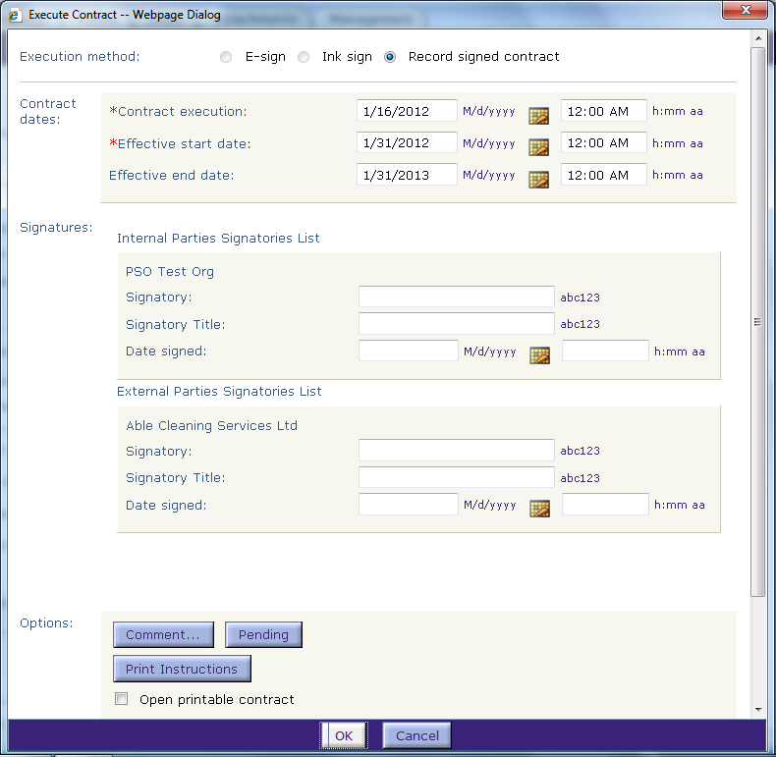
Execute Contract Dialog Box
The Contract Execution date, Effective Start date, and Effective End date are displayed.
  These were entered earlier on the Header tab.
  If these dates have changed, you will need to update them.
Enter the Name and Title of the signer for the Internal Party.
Enter the date signed or click the Calendar icon to select.

Slide 6
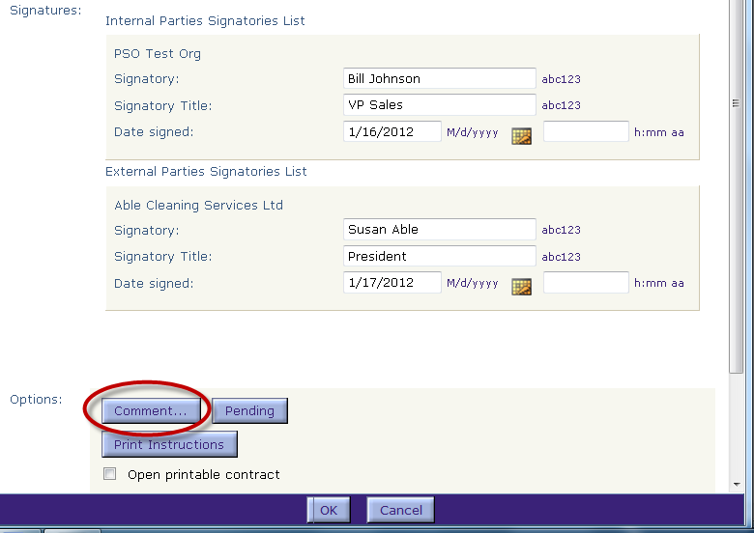
Enter the External Party Information
Enter the Name and Title of the External Party signer.
Enter the signature date or select the date using the Calendar icon.
If there are additional External Party signers, enter the information for each Organization and Signatory.
Click the Comment… button to enter a comment about the contract or task.
The Comment dialog box is displayed.

Slide 7
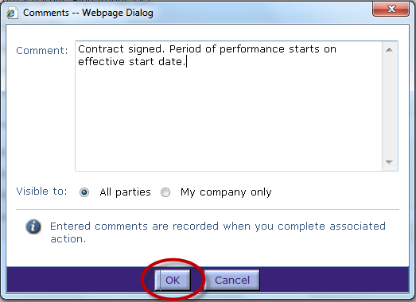
Enter External Party Information, cont.
Enter the comment.
Determine who will be able to view the comments.
Click OK when done.

Slide 8
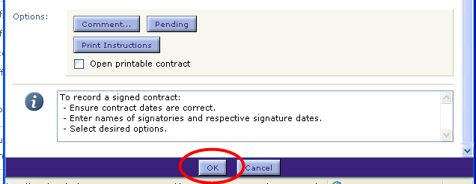
Execute the Contract
Click OK to finish executing the contract.
Note the advisories in the Information box.

Slide 9

Contract Status
The Contract Status is now set to Execute or Active.
  Note: You may want to edit the sub-status value to better reflect the task.
Execute status means that the contract has been signed, but the effective start date has not been reached.
Active status means that the contract has been executed, plus the effective start date has been reached.

Slide 10

Attachments
Before or after a contract is executed, you can attach files to the contract record.
Files attached before the contract is executed become part of the executed contract record.
  They may be sent to the external party in an email presentation.
  These attachments cannot be deleted after execution of the agreement.
Files attached after execution become part of the executed contract record but not shared with the external party.
  For example, you may attach a scanned copy of the signed contract after execution. However, in this particular case, attaching the signatures is not recommended, because the attachment can be deleted later. (So, attach the signatures before execution, if possible.)

Slide 11
After Contract Execution
Once a contract is executed:
    The Language view of the contract can be opened (read-only).
        Any “properties” that are part of the contract language are frozen. Details on this are on the next slide.
        If “frozen” properties need to be changed, an Amendment is required.
        You CAN add or change Terms, custom properties, comments, notes, substatus, security, lines, and any other properties not appearing in the Language view.
        You can delete comments, and version and revision history. It is nice to keep comments but they are subject to discovery if litigation occurs. There are permissions for these functions, so it is a customer decision to allow them or not.
    The contract cannot be “un-executed” or withdrawn.

Slide 12
What Freezes at Execution?
    Any “properties” that are part of the contract language are frozen. These include:
        Clauses, including underlying properties (system or user-defined)
        Contract Title
        Language Terms (including System Terms such as Effective Start/End Date, which are frozen when contract status becomes Active or Expired, even if not used in language)
        Attachments added prior to execution are frozen. (On the other hand, attachments such as scanned signatures can be added after execution.)
        Contract Lines (and hence Contract Total) are frozen only if the lines are included in the language as line clauses
        Contract parties, role, number of signatories, and addresses of internal parties

Slide 13

Questions?

